Slide 1
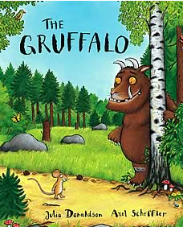
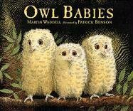
EYFS Autumn 2 Night and Day – I wonder which animals I will find in the woods?
There’s something magical about exploring a woodland area and wondering which creatures you might discover. This topic uses the story ‘The Gruffalo’ and ‘Owl Babies’, amongst other exciting reads, to inspire our own nature-filled forest adventures. The children will learn about differences between
night and day, including which animals might be awake and when. They’ll also learn about past
events through celebrating Bonfire Night and Diwali.
Communication and Language
The children will continue the Sounds Write phonics program to support their language development.
They’ll be exposed to a variety of rich vocabulary through daily stories, beginning to join in with familiar phrases.
They’ll be encouraged to ask questions and talk about things they’ve heard to develop their understanding.
They’ll be orally constructing sentences and beginning to write simple words and short phrases.
Physical Development
The key principle is to develop their fine and gross motor skills to support them in the following:
Putting on and taking off their coats and shoes independently, managing to manipulate zips and buttons independently.
Participating in PE lessons: gymnastics, stretching, curling and tackling obstacle courses
Ensuring that pencils and scissors are held correctly, engaging in playdough-based activities to support muscle development and strength.
Personal, Social and Emotional Development
Arrive at school happy and ready to learn
Greet other children and adults using their manners and kind words
Play cooperatively with peers
Line and queue up patiently
Express how they feel and listen to how others feel
Manage own basic hygiene needs
Expressive Arts
The children will have opportunities to express themselves in many ways:
Performing songs, rhymes, poems and stories
Exploring a variety of materials, tools and techniques.
Making use of props and materials when role playing characters in narratives and stories.
Mathematics
The children will continue to engage with maths through stories through:
representing numbers 4 and 5
composition of 4 and 5
subitising
one more and one less within 5
exploring patterns
identifying shapes
positional language
Understanding the World
The children will explore habitats found in woodland areas,
The children will explore how the nights are changing and getting darker.
They’ll observe any changes to the vegetables they planted previously
They’ll begin to learn about nativity plays and why Christians perform these
Literacy (reading, writing, transcription)
Learning to associate a letter with each of the taught sounds in Sounds Write
Reading simple words in line with their phonics knowledge
Writing some recognisable letters, forming simple CVC words in line with their phonics knowledge

