Slide 1
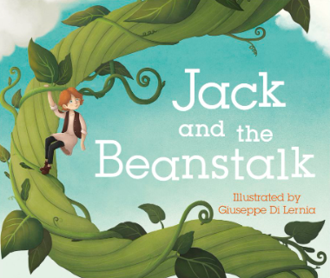

EYFS Spring 1– Where will my imagination take me?
Some of the most precious memories that we have from our childhood come from stories that we’ve read, or, heard read to us; especially fairy tales. They open up a whole new world for us to explore and allow our minds to wander. Jack and the Beanstalk is the first exciting fairy tale that we’ll be delving into. The children will be growing their own beanstalks, and using their imaginations to think about where it could possibly lead them to...
Communication and Language
The children will continue the Sounds Write phonics program to support their language development.
They’ll be exposed to a variety of rich vocabulary through daily stories, joining in with familiar phrases.
They’ll ask questions and talk about things they’ve heard to develop their understanding.
They’ll be orally constructing sentences and continuing to write simple words and short sentences with increasing independence.
Physical Development
The key principle is to develop their fine and gross motor skills to support them in the following:
Putting on and taking off their coats and shoes independently, managing to manipulate zips and buttons independently.
Participating in PE lessons.
Ensuring that pencils and scissors are held correctly, using playdough-based activities to support muscle development.
Tackling obstacle courses and negotiating different materials in order to construct .
Personal, Social and Emotional Development
Arrive at school happy and ready to learn.
Greet other children and adults using their manners and kind words.
Play cooperatively with peers, self-regulating when necessary.
Line and queue up patiently.
Express how they feel and listen to how others feel.
Manage their own basic hygiene needs.
Expressive Arts
The children will have opportunities to express themselves in many different ways:
Perform songs, rhymes, poems and stories .
Explore a variety of materials, tools and techniques.
Make use of props and materials when role playing characters in narratives and stories.
Mathematics
The children will continue to engage with the stories of Numberblocks and learn the following:
Numbers 6, 7, 8, 9 and 10.
Exploring the composition of these numbers.
Making comparisons.
Representing zero.
Literacy (reading, writing, transcription)
Associate a sound with each letter of the alphabet, as well as some sounds that have two letters that make one sound.
Read simple words in line with their phonics knowledge.
Write recognisable letters, forming simple CVC words, phrases and simple sentences
Understanding the World
The children will explore the season of ‘winter’.
They’ll learn all about the lifecycle of a plant.
They’ll have a go at growing their own beans, using their observational skills to identify any changes over time.

