Slide 1
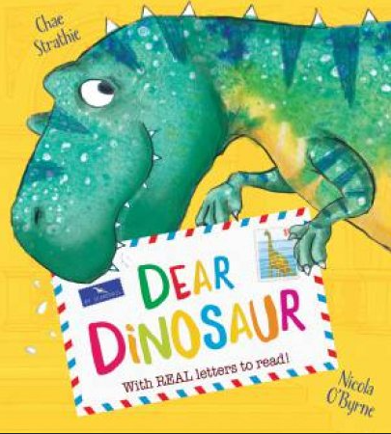
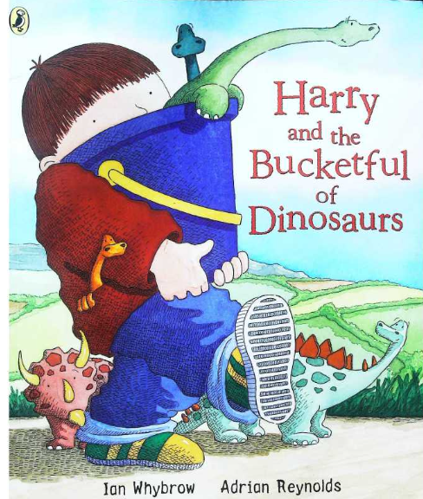
EYFS Spring 2– What existed before me?
Have you ever wondered what happened to the dinosaurs that once roamed our land? Or wanted to find out more about them? Then you’re in the right place! We’ll be digging into the past and exploring these once magnificent (if not a little scary) creatures. We’ll think like scientists and investigate possible ways that they became extinct as well as delving into the job of a palaeontologist to discover how we know what we already know about dinosaurs.
Communication and Language
The children will continue the Sounds Write phonics program to support their language development.
They’ll be exposed to a variety of rich vocabulary through daily stories, joining in with familiar phrases.
They’ll ask questions and talk about things they’ve heard to develop their understanding.
They’ll be orally constructing sentences and continuing to write simple words, phrases and short sentences.
Physical Development
The key principle is to develop their fine and gross motor skills to support them in the following:
Putting on and taking off their coats and shoes independently, managing to manipulate zips and buttons independently.
Participating in PE lessons.
Ensuring that pencils and scissors are held correctly, using playdough-based activities to support muscle development.
Tackling obstacle courses and negotiating different materials in order to construct.
Personal, Social and Emotional Development
Arrive at school happy and ready to learn.
Greet other children and adults using their manners and kind words.
Play cooperatively with peers, self-regulating when necessary.
Line and queue up patiently.
Express how they feel and listen to how others feel.
Manage their own basic hygiene needs.
Expressive Arts
The children will have opportunities to express themselves in many different ways:
Perform songs, rhymes, poems and stories .
Explore a variety of materials, tools and techniques,
Make use of props and materials when role playing characters in narratives and stories.
Mathematics
The children will continue to engage with the stories of Numberblocks and learn the following:
Exploring the composition of numbers 9 and 10.
Compare quantities up to 10
Addition and subtraction up to 10
Representing zero.
Literacy (reading, writing, transcription)
Associate a sound with each letter of the alphabet, as well as some sounds that have two letters that make one sound.
Read simple words in line with their phonics knowledge.
Write recognisable letters, forming simple CVC words, phrases and simple sentences.
Understanding the World
The children will further their understanding of the concept of ‘the past’.
We will discover the different names of dinosaurs, what they ate and how big they were.
We will make comparisons between how we know about our past and that of the dinosaurs.

