Slide 1
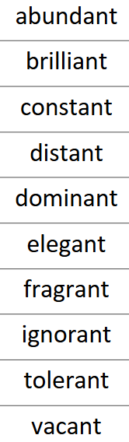



Homework due 7th November
Math’s:
This week, I have 3 activities on offer – you can complete any or all of them.
Additionally, you can choose to go onto Numbots – Story mode - or TTRS – Garage - 3 times during the week.
Spelling:
These will be tested in class on Friday 7th November
Copy your spellings into your homework book. Then get an adult to test you on them. Write sentences for those which you get wrong to learn them.
Alternatively, instead of writing sentences, create games with your adult to play using them. Remember that knowing the meaning of each word is just as important as spelling them correctly.
Reading:
Read your accelerated reading book to an adult 5 times during the week. Get your adult to ask and answer questions about what you have read.
© 2022

Slide 2
Homework due 7th November
Math’s:
This week, I have 3 activities on offer – you can complete any or all of them.
Additionally, you can choose to go onto Numbots – Story mode - or TTRS – Garage - 3 times during the week.
Spelling:
These will be tested in class on Friday 7th November
table apple bottle little middle able wobble multiple dazzle riddle
Copy your spellings into your homework book. Then get an adult to test you on them. Write sentences for those which you get wrong to learn them.
Alternatively, instead of writing sentences, create games with your adult to play using them. Remember that knowing the meaning of each word is just as important as spelling them correctly.
Reading:
Read your accelerated reading book to an adult 5 times during the week. Get your adult to ask and answer questions about what you have read.
© 2022

Slide 3
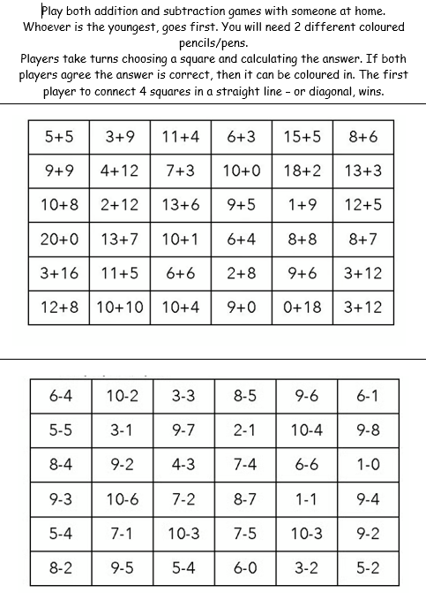

Slide 4
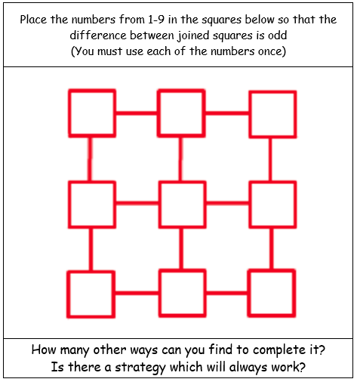

Slide 5


