Slide 1


Homework w/c: 10.10.2025
Maths:
Spelling:
Complete the task set on MyMaths. Remember to work through the lesson first.
Please also go onto TTRS to complete at least 3 Garage sessions
These will be tested in class on Friday 17th October
financial financially commercial provincial spatial palatial initial initially controversial controversially
https://app.mymaths.co.uk/4777-homework/more-addition-and-subtraction
Copy your spellings into your homework book. Then get an adult to test you on them. Write sentences for those which you get wrong to learn them. Alternatively, instead of writing sentences, create games with your adult to play using them. Remember that knowing the meaning of each word is just as important as spelling them correctly.
Reading:
Read your accelerated reading book to an adult 5 times during the week. Get your adult to ask and answer questions about what you have read.
© 2022

Slide 2
Homework w/c: 10.10.2025
Maths:
Spelling:
Complete the task set on MyMaths. Remember to work through the lesson first.
https://app.mymaths.co.uk/4777-homework/more-addition-and-subtraction
Please also go onto TTRS to complete at least 3 Garage sessions
These will be tested in class on Friday 17th October
gem giant magic giraffe energy jacket jar jog join adjust
Copy your spellings into your homework book. Then get an adult to test you on them. Write sentences for those which you get wrong to learn them. Alternatively, instead of writing sentences, create games with your adult to play using them. Remember that knowing the meaning of each word is just as important as spelling them correctly.
Reading:
Read your accelerated reading book to an adult 5 times during the week. Get your adult to ask and answer questions about what you have read.
© 2022

Slide 3
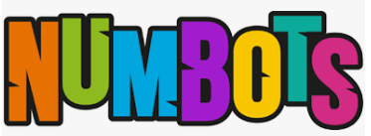
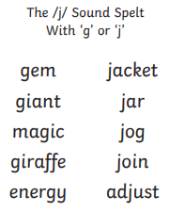
Homework w/c: 10.10.2025
Please go onto Numbots and go onto story mode at least 3 times in the week
Reading:
Read your accelerated reading book to an adult 5 times during the week. Get your adult to ask and answer questions about what you have read.
These will be tested in class on Friday 17th October
Copy your spellings into your homework book. Then get an adult to test you on them. Write sentences for those which you get wrong to learn them. Alternatively, instead of writing sentences, create games with your adult to play using them. Remember that knowing the meaning of each word is just as important as spelling them correctly.
Complete the task set on MyMaths. Remember to work through the lesson first.
https://app.mymaths.co.uk/3-homework/number-facts-and-doubles-3

