Slide 1

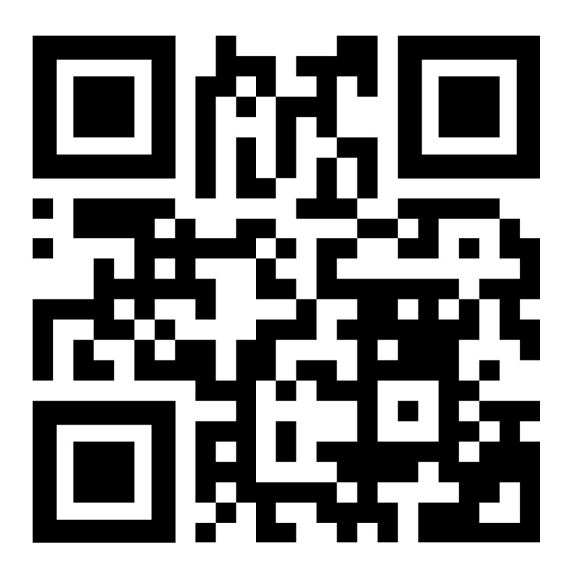

Homework w/c: 30.01.2026
Maths:
Spelling:
This week, we would like you to complete the attached maths and grammar sheets.
Please also complete at least 3 garage sessions on TTRS.
These are our spelling words for this week.
Practise each spelling and write a sentence for each word to show you understand its meaning. Remember to use your neat handwriting and correct punctuation.
These will be tested in class on Friday 6th February
bought
fought
thought
ought
sought
nought
brought
wrought
afterthought
thoughtfulness
You can find further revision games here: https://games.vocabularyninja.co.uk/
Extra challenge Can you add a modal verb to any of your sentences?
Don't forget to read at least 5 times to an adult at home.
© 2022

Slide 2

Homework w/c: 30.01.2026
Maths:
Spelling:
This week, we would like you to complete the attached maths and handwriting sheets.
Please also continue to practise on Numbots.
These are our spelling words for this week.
Practise each spelling and write a sentence for each word to show you understand its meaning. Remember to use your neat handwriting and correct punctuation.
These will be tested in class on Friday 6th February
patting
patted
humming
hummed
dropping
dropped
sadder
saddest
runner
runny
You can find further revision games here: https://games.vocabularyninja.co.uk/
Extra challenge: Can you add a fronted adverbial to any of your sentences?
Don't forget to read at least 5 times to an adult at home.
© 2022

