Slide 1

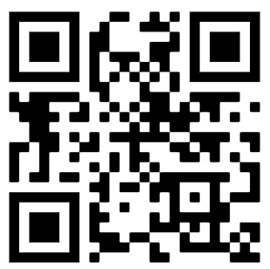

Homework w/c: 09.01.2026
Maths:
Spelling:
This week, we would like you to complete the attached math's and grammar sheets.
Please also complete at least 3 garage sessions on TTRS.
These are our spelling words for this week.
Practise each spelling and write a sentence for each word to show you understand its meaning. Remember to use your neat handwriting and correct punctuation.
These will be tested in class on Friday 16th January
afterwards
immediately
earlier
eventually
previously
finally
recently
yesterday
tomorrow
whilst
You can find homework help on BBC bitesize if needed.
Extra challenge: Can you add a fronted adverbial to any of your sentences?
Don't forget to read at least 5 times to an adult at home.
© 2022

Slide 2
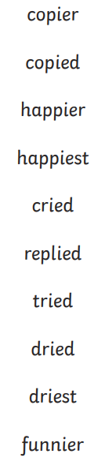

Homework w/c: 09.01.2026
Maths:
Spelling:
This week, we would like you to complete the attached math's and grammar sheets.
Please also continue to practise on Numbots.
These are our spelling words for this week.
Practise each spelling and write a sentence for each word to show you understand its meaning. Remember to use your neat handwriting and correct punctuation.
These will be tested in class on Friday 16th January
copier
copied
happier
happiest
cr
finally
recently
yesterday
tomorrow
whilst
You can find homework help on BBC bitesize if needed.
Extra challenge: Can you add a fronted adverbial to any of your sentences?
Don't forget to read at least 5 times to an adult at home.
© 2022

